Slide 1
Project: Coaching Management System Team:9 Team Members: 1. Nibir Ahmed 2011333642 2. Maliha Anzum Maisha 2011380642 3. Mashiyat Bashir 2013728042 4. Senova Mostafa 2011005642
..

Slide 2
About our system:
Our management provides a real world solution to the teaching system.
This is a platform where you can find all features starting from:
Enrolling into the course Emails
Course fee payment SMS facility
Online classes Payment gateway
Basically a one-stop-solution to save the teachers valuable time.
Surely will make the learning more interactive. And less missing payments

Slide 3
01
Conceptual Foundation
Let’s talk about it.

Slide 4
Tutoring Is Everywhere
Many teacher even university big brothers are teaching but don’t have any management system. It’s rather expensive or not easy to use.
LOGIN
NEW ACCOUNT

Slide 5
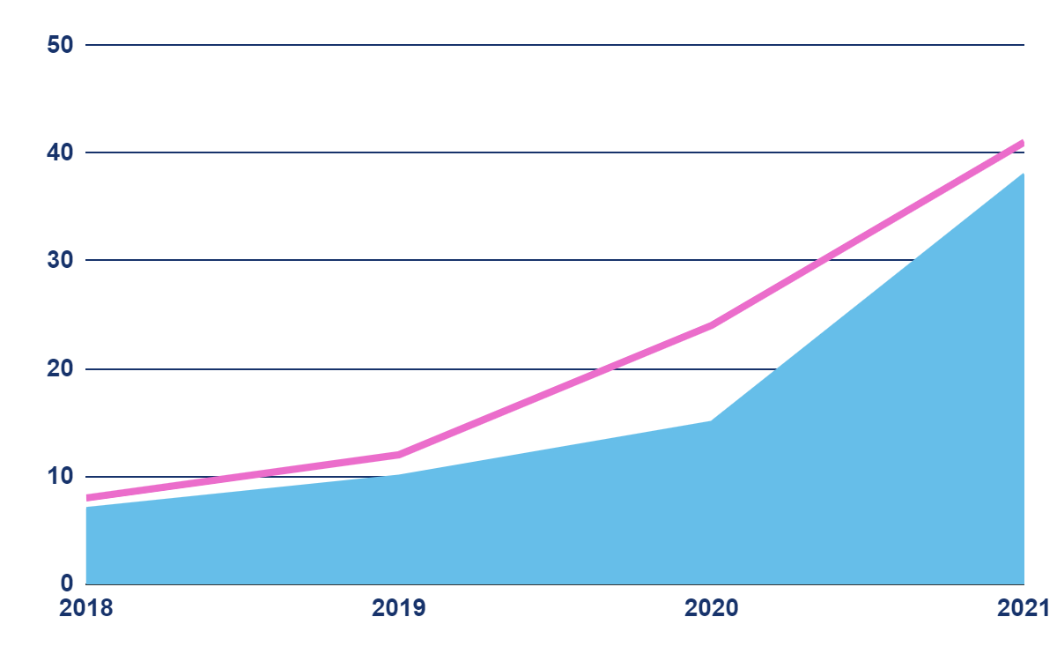
Market
Total Teachers
In Bangladesh
7,61,989
By 2018 and Increasing
Source: https://en.wikipedia.org/wiki/Education_in_Bangladesh

Slide 6
Market
Teachers
Who Are Tutoring
1,00,000
Let’s assume!!

Slide 7
Does the team demonstrate a thorough understanding of the need, problem or opportunity?
Definitely Yes. We took some time, done our discussion and now we feel the necessity of this system with a huge market gap.
USERNAME
PASSWORD
LOGIN

Slide 8
Is the project’s purpose and basic functionality easily understood?
As this software will be used by teachers and students so making it easy is a must. Yes and lets talk about it
USERNAME
PASSWORD
LOGIN

Slide 9
THANKS!
We are available for you!!

